Slide 1
Lecture 7:
2.3. Why Was Pre-Industrial Progress so Slow on Average?
Brad DeLong
Department of Economics and Blum Center, U.C. Berkeley; WCEG; and NBER
last revised: 2020-02-06
for presentation: 2020-02-13
Original course by Melissa Dell (Harvard Econ 1342), revised by Brad DeLong, research assistance by Anish Biligiri
<https://github.com/braddelong/public-files/blob/master/econ-135-lecture-7.pptx>

Slide 2
Roadmap for the Next Week
7. Why Was Pre-Industrial Progress so Slow on Average? (Feb 13):
Read Before: Josh Ober (2019): Agamemnon's Cluelessness, selections <https://delong.typepad.com/files/ober-agamemnon-selections.pdf>
Read Before: Moses Finley: Technical Innovation and Economic Progress in the Ancient World <https://delong.typepad.com/finley-technical.pdf>
Slides: <https://github.com/braddelong/public-files/blob/master/econ-135-lecture-7.pptx>
Start: Assignment 5: Simulations with the Solow growth model; due Feb 19 <https://bcourses.berkeley.edu/courses/1487685/assignments/8065916>
8. Commercial Revolutions (Feb 18):
Read: Christopher Berry (2018): Adam Smith: A Very Short Introduction <https://delong.typepad.com/files/berry-smith.pdf>
Slides: <https://github.com/braddelong/public-files/blob/master/econ-135-lecture-8.pptx>
Finish: Assignment 5: Simulations with the Solow growth model; due Feb 19 <https://bcourses.berkeley.edu/courses/1487685/assignments/8065916>
9. Industrial Revolutions (Feb 20):
Read Before: Robert Allen (2017): The Industrial Revolution: A Very Short Introduction, selections <https://delong.typepad.com/files/allen-industrial.pdf>
Read Before: Joel Mokyr (1990): Lever of Riches, chapter 5 “The Years of Miracles” <https://delong.typepad.com/files/mokyr-lever-revolution.pdf>
Read Before: Karl Marx and Friedrich Engels (1848): The Communist Manifesto <https://www.marxists.org/archive/marx/works/download/pdf/Manifesto.pdf>
Slides: <https://github.com/braddelong/public-files/blob/master/econ-135-lecture-9.pptx>
Start: Assignment 6: slow technological and organizational progress before 1500 paper; due Mar 1
10. Exam (Feb 25):
Instructor Reality Check
60% short answers; 40% essay

Slide 3
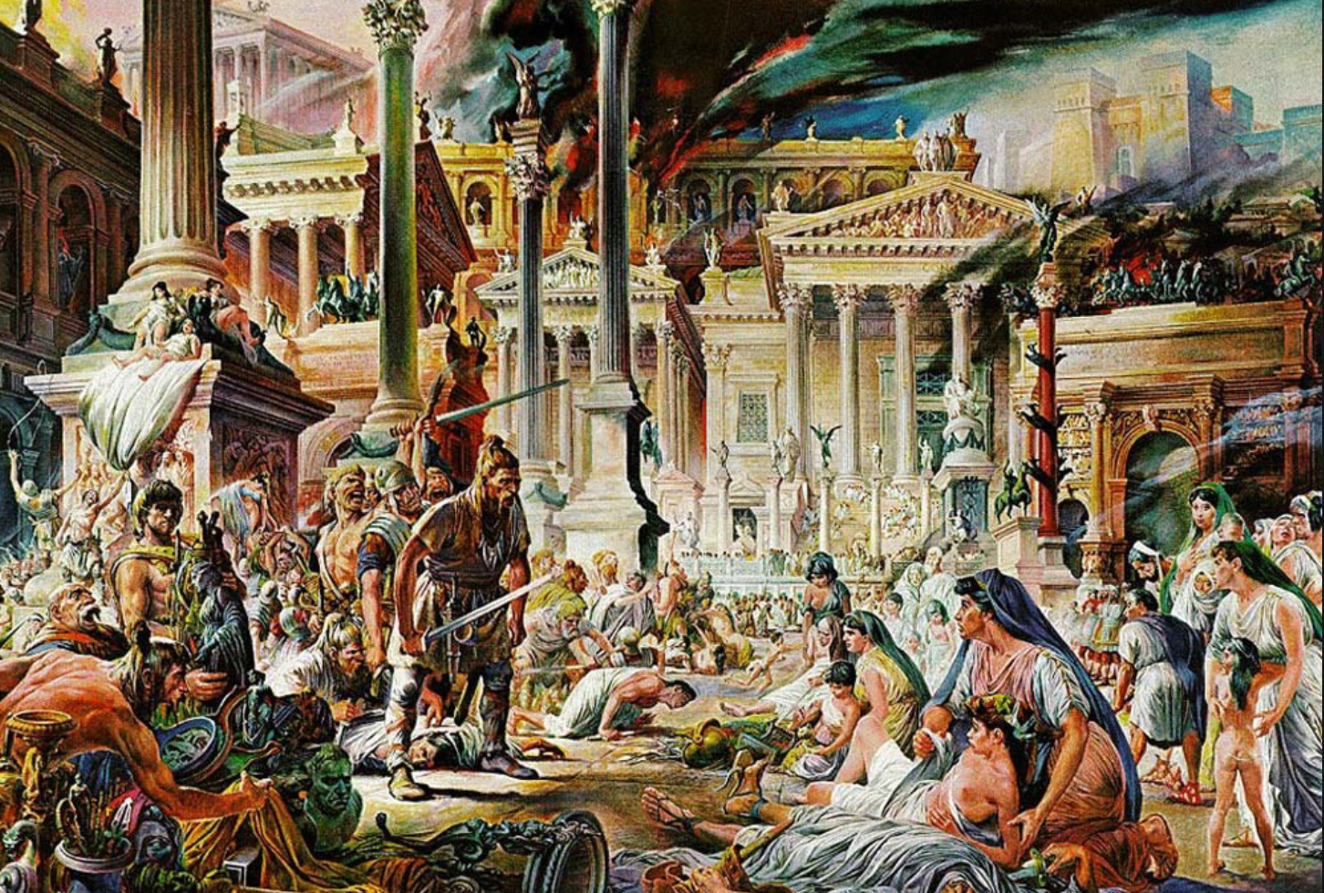


The Fall of Rome
Economic Zenith, Then Economic Decline, Then Political Decline:
While the existing data are somewhat contradictory, the consensus amongst archaeologists is the early 2nd century.
A new social distinction between honestiores (high status) and humiliores (low status with different laws) was introduced.
Citizens began to lose their rights and by the end of the 2nd century, they were being tied to the land as serfs
The Barbarians were at the gates, but it seems reasonable to see this as an outcome of the weakening of Roman institutions
Earlier Rome had defeated far more formidable and better organized enemies like the Carthaginians.
Acemoglu and Robinson argue that the big fact about what preceded the decline is that political institutions moved in a much more extractive direction and this was followed by economic institutions.
Jongman (“Gibbon was Right”) proposes that the Antonine plague which hit the Roman Empire around 160AD is the most likely explanation for the collapse of Rome.
But Malthusian crises are supposed to increase living standards, not reduce them: so what is going on?
Slide taken from Melissa Dell

Slide 4
Three Great Plagues
But the demands of the empire for revenue and of the upper class for resources remain the same:
Antonine Plague (smallpox?): Antonine ⇒ Severian dynasty
Plague of St. Cyrian (Ebola-like?): Things fall completely apart, then Diocletian: between Philip the Arab and Diocletian, 18 emperors in 35 years, plus two breakaways; 12 of the 18 were assassinated
Plague of Justinian (Bubonic): Flavius Apion…

Slide 5
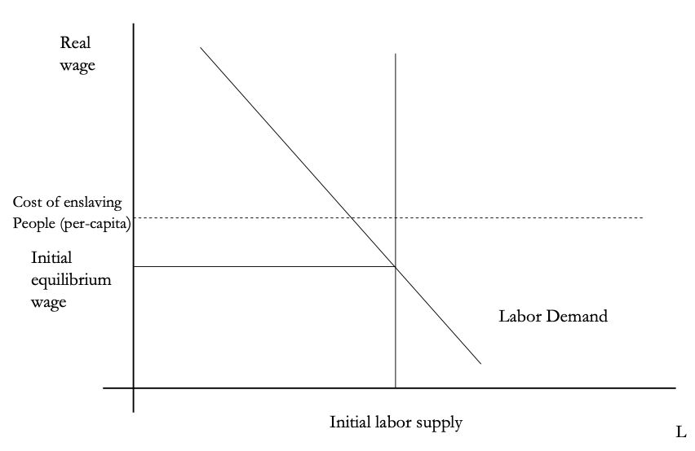
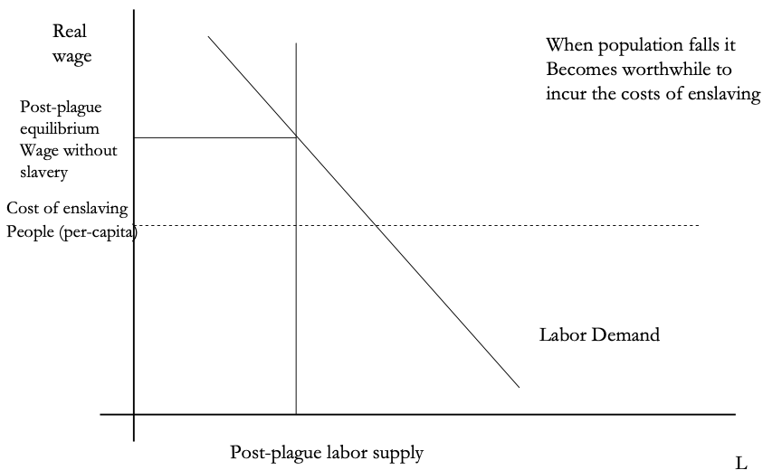
The Domar Hypothesis
You can have a leisured upper class, or abundant land relative to labor, or free labor, but not all three at once:
Slide taken from Melissa Dell

Slide 6
Dell’s Summary of Acemoglu and Robinson on the Rise and Fall of Rome
“Efflorescence” driven by good institutions:
Historically economic growth coincided with institutional innovation: creation of states with working political institutions that could provide public goods, law and order, encourage trade etc.
Functioning states could also raise taxes and fund armies, allowing widespread conquests.
However, they argue these were fundamentally extractive institutions, even if in some cases economic institutions were initially relatively inclusive.
They argue that extractive growth is not sustained because there is little technological change. Moreover, it naturally creates political instability which eventually destroys the institutions which started the growth.
Slide taken from Melissa Dell

Slide 7
The Later Roman Empire
How does it compare to the expanding Roman Republic?
Militarism: in striking contrast to earlier days, a successful general is a threat to the emperor. Eighteen emperors in 35 years between Philip the Arab and Diocletian
Mobilization: In order to extract resources from a smaller population, the people must be disarmed rather than mobilized.
Distribution: The smaller pool of benefits needs to be hoarded for those with connections, not shared.
Incorporation: You can join the Goths: you cannot join the Roman upper class unless you know someone…

Slide 8
Flavius Apion
Peter Sarris on Justinian I in 542:
Writing to his Praetorian Prefect concerning the army—trained and equipped and paid for by the Roman State to control the barbarians and to "increase the state." Peter Sarris reports in his Economy and Society in the Age of Justinian, upset that:
Certain individuals had been daring to draw away soldiers and foederati from their duties, occupying such troops entirely with their own private business.... The emperor... prohibit[ed] such individuals from drawing to themselves or diverting troops... having them in their household... on their property or estates.... Any individual who, after thirty days, continues to employ soldiers to meet his private needs and does not return them to their units will face conﬁscation of property... "and those soldiers and ﬁoderati who remain in paramonar attendance upon them... will not only be deprived of their rank, but also undergo punishments up to and including capital punishment."

Slide 9
Anoup
One of Flavius’s tenants and debtors, Anoup, wrote:
No injustice or wickedness has ever attached to the glorious household of my kind lord, but it is ever full of mercy and overflowing to supply the needs of others.
On account of this I, the wretched slave of my good lord, wish to bring it to your lordship's knowledge by this present entreaty for mercy that I serve my kind lord as my fathers and forefathers did before me and pay the taxes every year. And by the will of God... my cattle died, and I borrowed the not inconsiderable amount of 15 solidi....
Yet when I approached my kind lord and asked for pity in my straits, those belonging to my lord refused to do my lord's bidding. For unless your pity extends to me, my lord, I cannot stay on my ktema and fulfill my services with regard to the properties of the estate.
But I beseech and urge your lordship to command that mercy be shown to me because of the disaster that has overtaken me...

Slide 10
Not “Legible” to the State
Justinian knows very well that the countryside is not legible to him:
The contracts that Flavius Apion makes with his tenants are made under the shadow of the threat that if Flavius Apion does not like the way things are going he will send a bucellarius to beat you up.
Anoup is not pointing out to Flavius Apion that their landlord-tenant relationship is a good thing and that keeping him as a tenant rather than throwing him off the land for failure to pay the rent is in both their interests.
Instead, Anoup is calling himself a slave (which he is not). Anoup is calling Flavius Apion a lord (which he is not supposed to be). Anoup is appealing to a long family history of dependence of himself and his ancestors on the various Flavii Apionoi and Flavii Strategioi of past generations.
Justinian thinks that things would be better served if the countryside were properly legible to him and he could enforce reality to correspond to the legal order of slaves and citizens, tenants and landlords interacting through contract, and taxpayers.
Flavius Apion would prefer that the order be one of proto-feudalism: that all the Anoups know and understand that they are at his mercy, and that the emperor is far, far away.
And we don't know what Anoup thinks:
We do know that does not sound as though he experiences the lack of legibility of the countryside to the emperor and his state as a full and complete liberation.
And we do know that the Emperor Justinian was gravely concerned about the transformation of his soldiers into bucellarii, into the dependent bully-boys of the landlords—both because it meant that they were not on the borders where they belonged and because it disturbed what he saw as the proper balance of power in the countryside and what he saw as the emperor's justice.

Slide 11
Dell’s Summary of Acemoglu and Robinson on the Rise and Fall of Rome II
For the Roman Empire, the collapse of Roman authority was pronounced, particularly in the West:
By 450AD all the trappings of Roman economic prosperity were gone.
Money vanished from circulation.
Urban areas were abandoned and buildings stripped of stone.
The roads were overgrown with weeds.
The only type of pottery which was fabricated was crude and hand made, not manufactured.
People forgot how to use mortar and they also forgot how to read and write.
Roofs were made of branches, not tiles.
The Eastern Roman Empire lived on, but it contracted significantly with the rise of Islam in the 7th Century.
Slide taken from Melissa Dell

Slide 12
Subsequent Evolution of Western Europe
Land Ownership and Exploitation in a Nutshell:
Peter Temin: Land Tenure and Exploitation from the Roman Empire to Lord Peter Wimsey <https://www.bradford-delong.com/2020/02/weekend-reading-peter-temin-land-tenure-and-exploitation-from-the-roman-empire-to-lord-peter-wimsey.html>...

Slide 13

Why Was Pre-Industrial Progress so Slow on Average?
Our readings:
Willem M. Jongman (2007): Gibbon was Right: The Decline and Fall of the Roman Economy <https://delong.typepad.com/jongman-gibbon-was-right.pdf>
Peter Temin: The Roman Market Economy, Roman Growth <https://delong.typepad.com/files/temin-roman-growth.pdf>
Moses Finley: Technical Innovation and Economic Progress in the Ancient World <https://delong.typepad.com/finley-technical.pdf>
Josh Ober (2019): Agamemnon's Cluelessness, selections <https://delong.typepad.com/files/ober-agamemnon-selections.pdf>

Slide 14
Potential Points of View
What are the possibilities here?:
No puzzle—given how few heads they had, and given the absence of printing and the difficulty of controlled experiments, it is a miracle that they managed to advance technology as far as they did as fast as they did…
No: there was something wrong. They had the wrong kind of society…
No: something went wrong: civilization seems to be progressing up to the year 1… 0.013%/yr… 0.030%/yr… 0.061%/yr… & then it stalls out: instead of doubling to a Commercial Revolution rate of growth after the year 1, the rate of ideas growth halves again…

Slide 15
Our Four Readings I
What possibilities do they argue for?:
Jongman:
“Population went down… production per man hour must have gone up….. Conversely, rents must have gone therefore the incomes of elite land-owners. The Roman Empire should have turned into a world of happy and prosperous peasants, and much greater social equality than before. The theory is impeccable, but reality was, of course, different. What we witness from the late second century is the emergence of a new social, political, and legal regime, where oppression replaces the entitlements of citizenship…”
Temin:
“The high ratio of wages to energy costs was not only absent in eighteenth-century continental Europe; it was absent as well in the Roman Empire. Despite the technical progress being made then that we are discovering more about, there was no possibility of escaping from the Malthusian constraints with the price ratios that existed then. However prosperous Rome may have been, it was not on the verge of having an Industrial Revolution. There was no analog of the British coal industry in antiquity and therefore no possibility that industrialization could have begun in the ancient world.

Slide 16
Our Four Readings II
What possibilities do they argue for?:
Finley:
“The pejorative judgments of ancient writers about labour, and specifically about the labour of the artisan, and of anyone who worksfor another, are too continuous, numerous, and unanimous, too wrapped up in discussions of every aspect of ancient life, to be dismissed as empty rhetoric. In other slave-owning societies for whom there is fuller documentation, these implications and their practical effects are unmistakable.
“Writing about the Great Trek, for example, Sir Keith Hancock said: 'The Boers very soon convinced themselves that artisans' work and slaves' work were the same thing—a conviction which struck such deep roots in their minds that their descendants in the nineteenth century left to British immigrants almost all the opportunities of skilled industrial employment in the expanding towns'.
“Or Tocqueville, whose I83I notebooks are filled with the theme that 'slavery is even more prejudicial to the masters than to the slaves', because, as a leading Louisville merchant said to him, 'it deprives us of the energy and spirit of enterprise that characterizes the States that have no slaves’.
“Greek and Roman slavery functioned in a different context, to be sure, both internally and externally, and comparisons must be made with caution and reserve. But this particular one seems to me to be valid and necessary…”
“Nothing that I have said should be taken to suggest that there was no technical or economic progress whatever in antiquity. Obviously the range and quality of products were enhanced and standards of life rose, at least for the rich. The spread of urbanization suggests, and the quality of urban living confirms, that a larger share of the total income was available for non-productive expenditure…”

Slide 17
Our Four Readings III
What possibilities do they argue for?:
Ober:
“If the 'substantial growth’ conclusion is correct, as I suppose it to be, it appears that in practice, at least, Greeks were quite capable of the kind of reasoning necessary to build and sustain a growing economy. That is to say, ancient Greeks, as individuals and collectives, frequently employed economic rationality, i.e. rationally instrumental reasoning in economic contexts. It is nonetheless undeniable that there is a body of classical literature that exemplifies the scorn for money-making that was emphasized by the Finley school. Those expressions of scorn underpin the theory of an essentially timeless and changeless ancient economy predicated on violent extraction and gift exchange.
“The many surviving works of classical-era Socratics—Plato, Xenophon, and Aristotle—figure prominently in that ancient body of evidence. While scorn for trade and commerce can indeed be found outside the philosophical corpus, absent the works of the Socratic philosophers, our sense of what ‘Greek literature’ has to say about economic activity would be very different.”
“The approach of the Socratic philosophers to economic rationality was fundamentally critical and normative…. For Finley and his school, social status remained foundational; any activity that was not grounded in status, and in the power relations thought to inhere in status relations, was, consequently, unmoored and ephemeral.
“Economic activity aimed at increasing productivity, innovations aimed at increasing efficiency, and increased consumption—rather than securing the status of the relevant actors—were, thereby, rendered more or less invisible—and in any event, unworthy of detailed study. The result was, so I suppose, both a misunderstanding of the relevant texts and a misrepresentation of the underlying social reality…”

Slide 18
Review: What Should We Review Today?
A number of possibilities:
The grand overview of the history of economic growth
Models:
The Solow growth model
Malthusian forces
“Two heads (almost) twice as good as one” & “low-hanging fruit is picked first” & “institutions matter a lot”
Malthusian economics
& “class power”
Measuring prosperity relative to “subsistence”
Ancient empires (& their rise & fall)

Slide 19
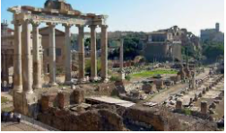
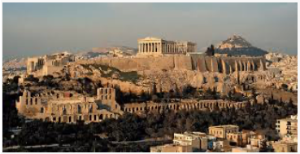
Big Ideas: Lecture 7: Slow Ideas Growth in the Past
Takeaways from this lecture:
OK: What should the takeaways from this lecture be?

Slide 20
Catch Our Breath…
Ask a couple of questions?
Make a couple of comments?
Any more readings to recommend?

Slide 21
Notes

